Slide 1
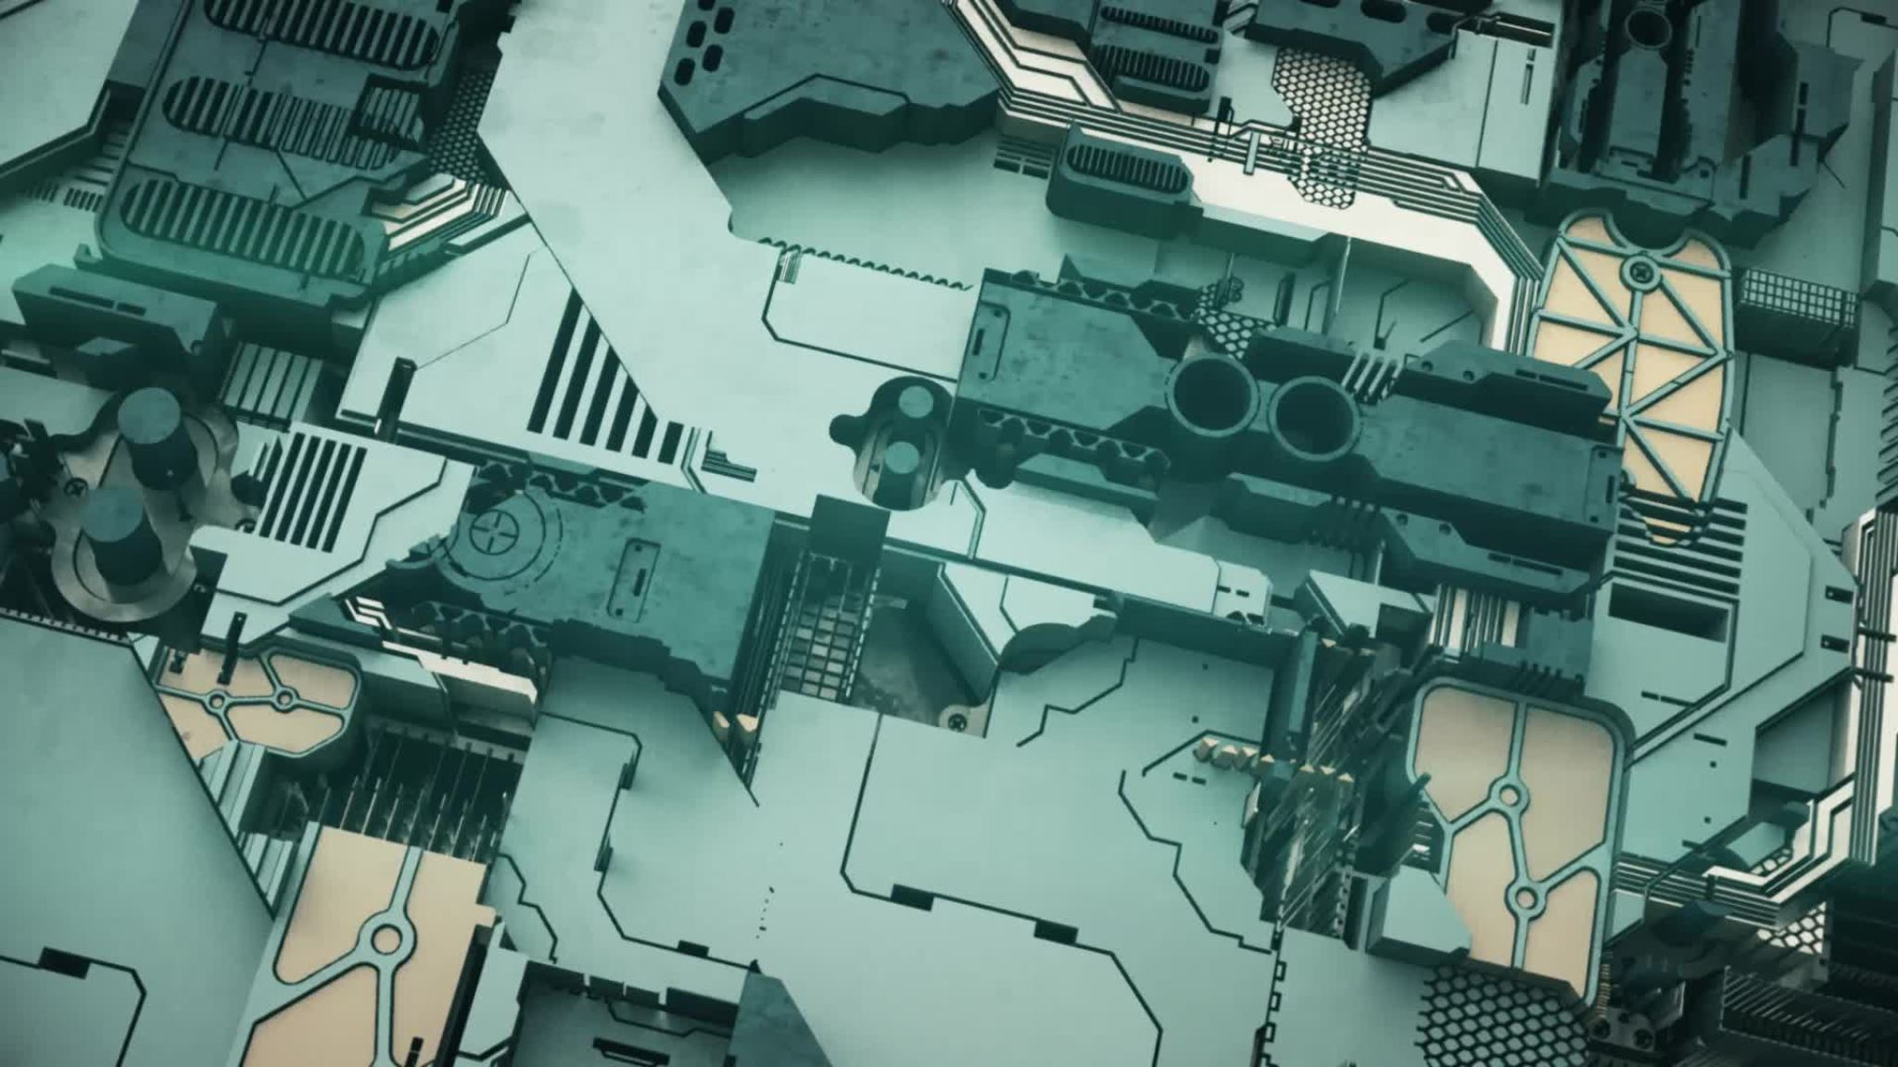
Minimal CPU Architecture for Washing Machine
KP.SURYA(RA2211026010378)
S.KOUSHIK VISHAL(RA2211026010384)
RAJVI DEERAJ(RA2211026010375)

Slide 2
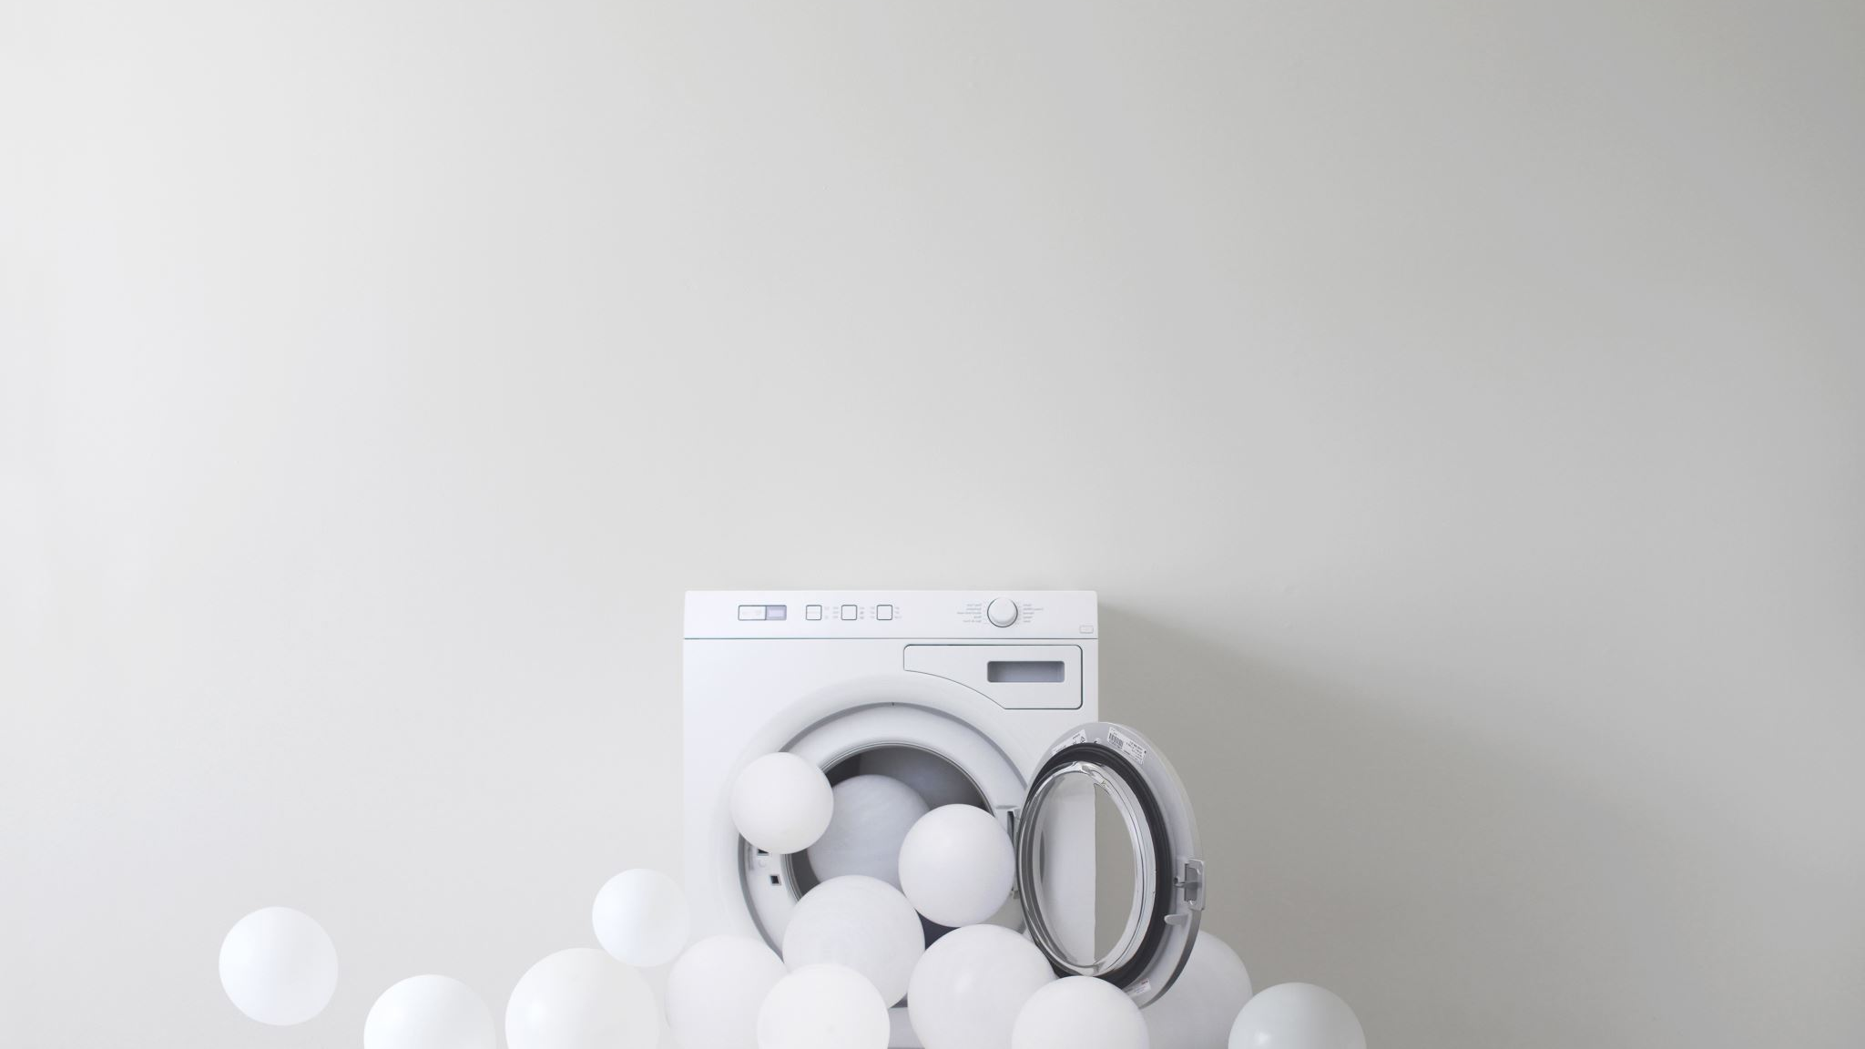
Introduction
To create a minimal CPU architecture for the functions of a washing machine.
Considering the complex nature of functions of a washing machine, we will simulate a drawn down model emphasizing two major functions – OFF state and WASHING state.

Slide 3

Basic State Machine
State Machine - Used to represent different possible states the system can be in and transition between states.
In the context of the Washing machine – Two primary states: “OFF and WASHING”.

Slide 4

Constants and Initialization
Initial State of machine is set to OFF
offIterations and washingIterations are variables used for state duration control; these variables control how long the washing machine remains in each state.

Slide 5

Main Loop and Iterations
Main loop is central control mechanism of the machine.
It operates on the basis of specific instructions embedded within each function and executes these instructions when called.
Iteration and numIterations is fundamental to the duration of the simulation to prevent indefinite run, allows for orderly execution of machine control logic within fixed number of iterations.

Slide 6

Sample Assembly code
ORG 0x0000 ; Start address
START:
LD R0, 0x01 ; Initialize R0 with the default program state
ST R0, MachineState
; Main loop
LOOP:
LD R1, MachineState
CMP R1, 0x01 ; Check the current machine state
BEQ OFF ; If it's in the OFF state, do nothing
CMP R1, 0x02 ; Check if it's in the WASH state
BEQ WASHING
; Other states and control logic go here
JMP LOOP ; Continue the loop

Slide 7
OFF:
; Turn off the washing machine
; Code for turning off the machine goes here
JMP LOOP
WASHING:
; Perform the washing cycle
; Code for washing goes here
; Update machine state
LD R2, 0x03
ST R2, MachineState
JMP LOOP
MachineState: ; Variable to store the current machine state
DB 0x01 ; Initial state: OFF
; Define other variables, I/O ports, and states as needed
END

Slide 8

Conclusion
The simulation is simplified to only show two primary state as it is impractical and complex to cater to every scenario.
Washing Machine control systems involve various sensors, user inputs and more complex logic.

